Slide 1
Sales Prediction Data Task
By Nickolas Theodoulou

Slide 2
Outline
SVM – Best Model
Exploration – Interesting Features
Pre-Processing - Imputation and Transformations
Modeling – Grid Search and Fitting
Conclusion – Other Useful Data and Extension

Slide 3
Best Model - SVM
SVM was found to perform the best using 10-fold cross validation with:
Mean - 88.3% accuracy, SD - 0.57
And hyper-parameters: gamma = 1/16, C=10

Slide 4
Data Exploration - Overview

Slide 5
Data Exploration – Correlated Attributes
Price and Tax were found to be highly correlated from a heat-map
Linearly dependent following two different equations:
Tax = Price * 0.1 or Price * 0.05.
Hence both attributes were used to impute the other using a cutoff value for 0.1 or 0.05.

Slide 6
Data Pre-Processing - Imputing
Attempted to use K-NN to impute attributes – using Package: FancyImpute - large computational cost.
Hence standard methods such as mean, mode and median were used to impute other attributes.

Slide 7
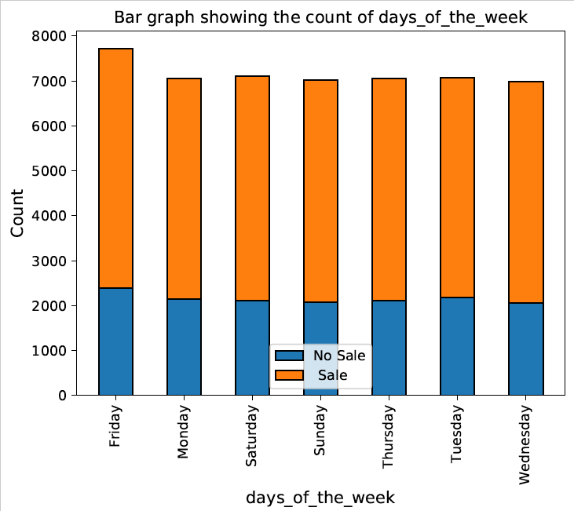
Data Exploration – Feature Engineering
Days of Week extracted from the attribute Date
On Friday more sales are made
Month and Year were extracted - no new information

Slide 8
Data Pre-Processing – One Hot Encoding
Credit Score had an interesting distribution with customers fitting a bell shape apart from the value 9999.
Attempted to one-hot encode.

Slide 9
Data Pre-Processing
Attributes normalised to have a mean of 0 and standard deviation of 1 before fitting.
No attribute was found to be heavily skewed so log and box-cox transformations were not used.
One hot encoded Marital Status and Days of the Week.

Slide 10
Data Modeling
The data was first modeled using K-NN, with k=5, dropping all missing values to see how the data would perform. Accuracy ~ 84%
After Pre-Processing, grid search and 10-fold cross validation, the optimum value for K was found to be 15 leading to:
Mean – 87.4% accuracy, S.D- 0.55
SVM performed better: Mean - 88.3% accuracy, SD- 0.57

Slide 11
Conclusion - Other Useful Data
Ideal to have more data on customers with no Sale.
As ‘Date’ was included, Time would have been useful as more sales are likely to occur at certain times of the day.
Having a customer ID would be useful as the same customer could be inquiring for a quote and this would affect the model.

Slide 12
Conclusion – Improving the Model
Overall the SVM was accurate. Further improvements include:
Create a method to impute missing values using K-NN
Fit other ML models after Pre-Processing and compare them
Stack different models as one could be data points where one model could perform better

Slide 13
Further Questions

